Slide 1

CONCEPTS OF PROGRAMMING LANGUAGES
12th Edition
Chapter 2
Evolution of the Major
Programming Languages

Slide 2
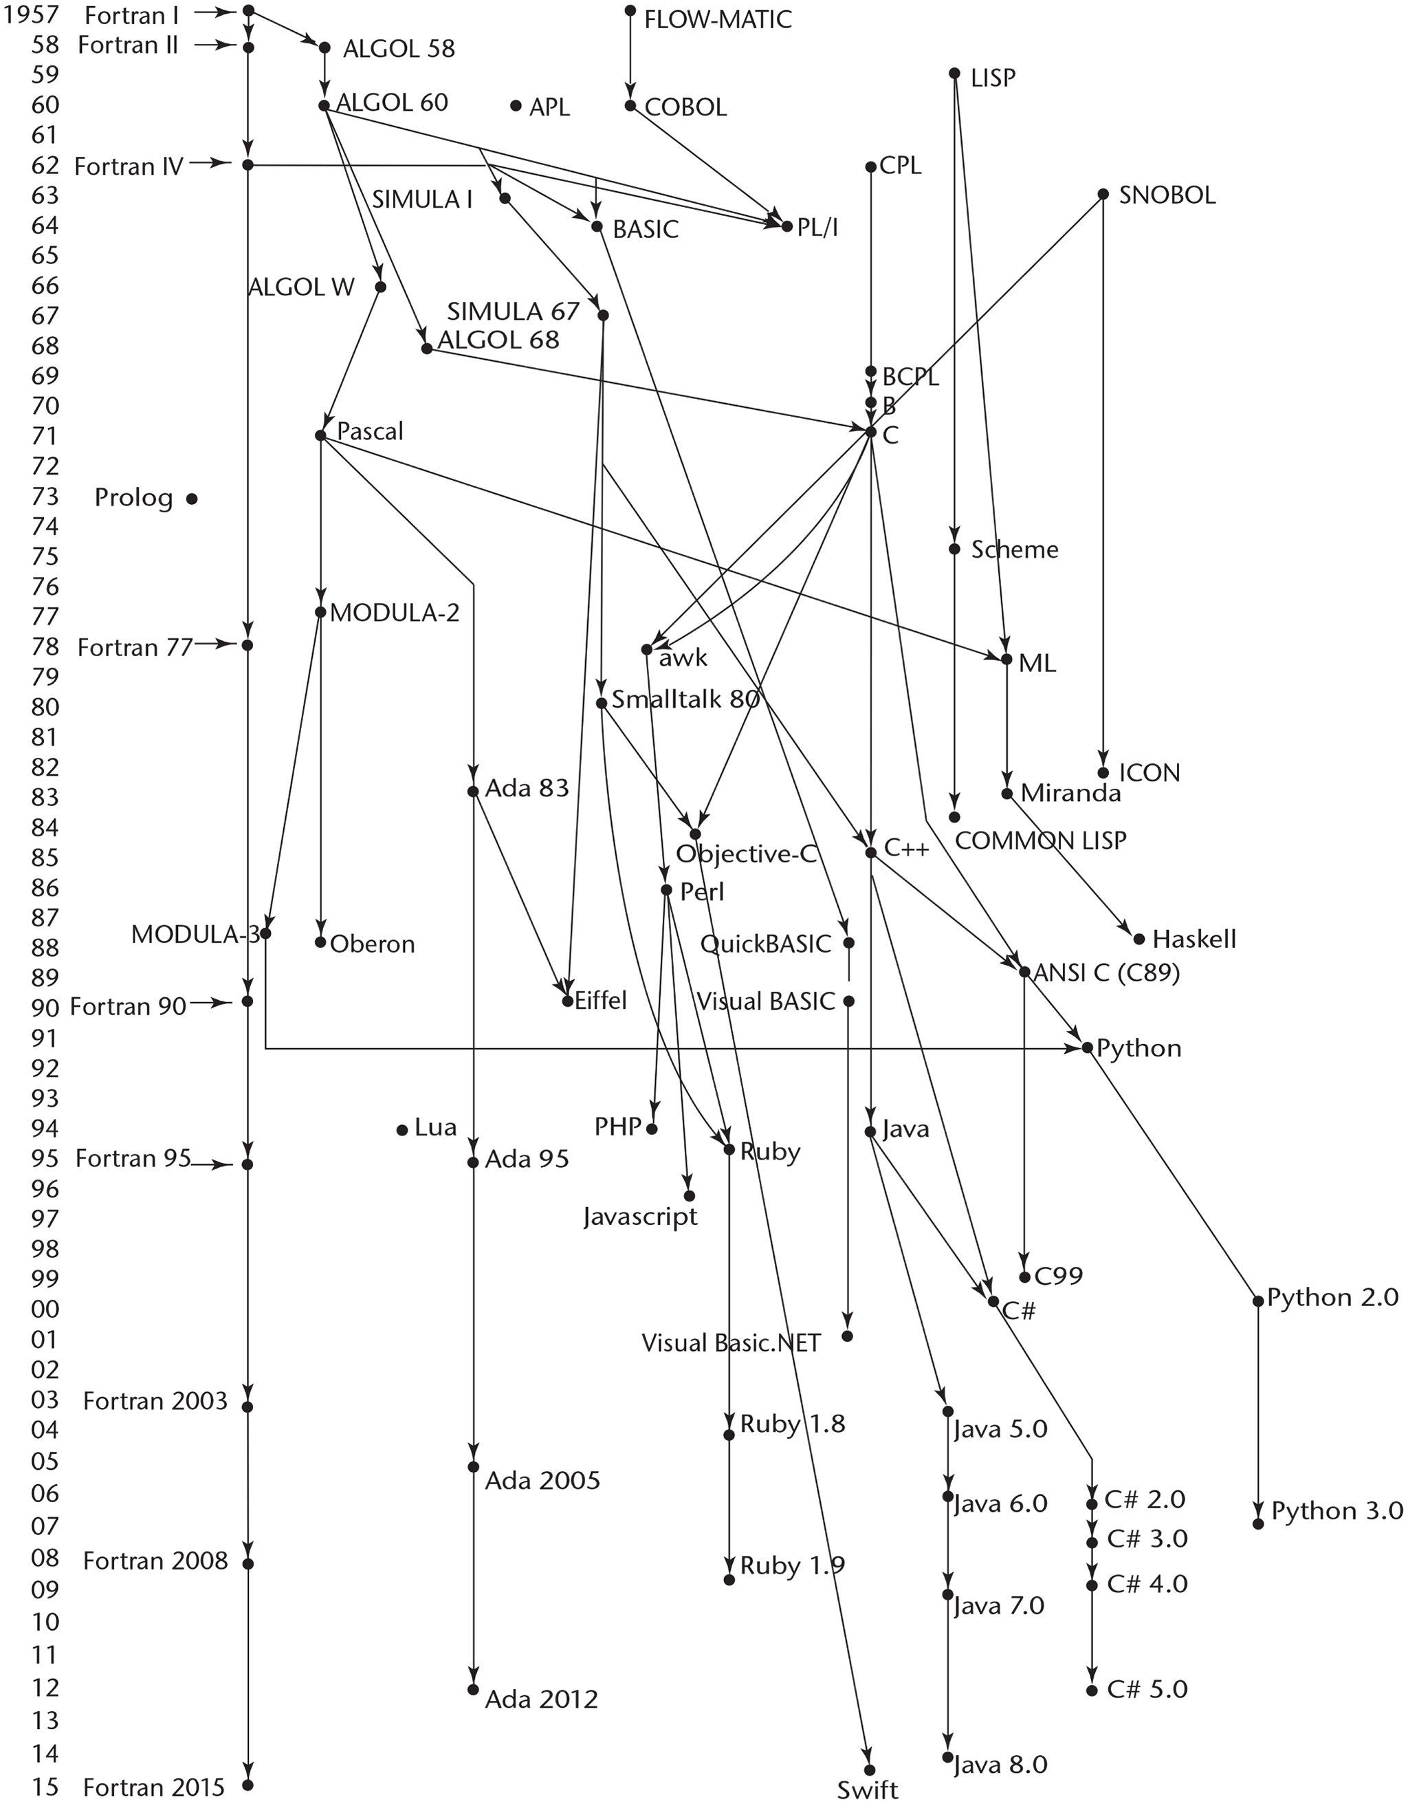
Figure 2-1 Genealogy of common high-level programming languages

Slide 3
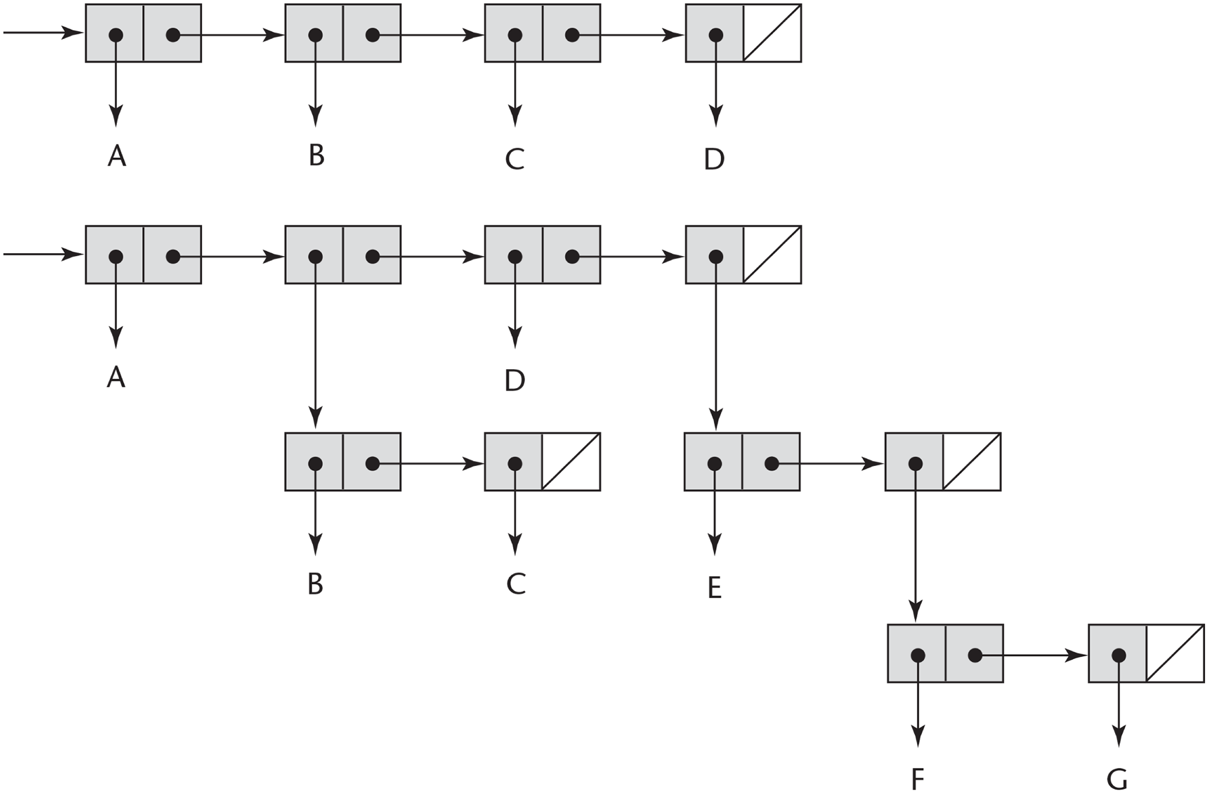
Figure 2-2 Internal representation of two Lisp lists

Slide 4
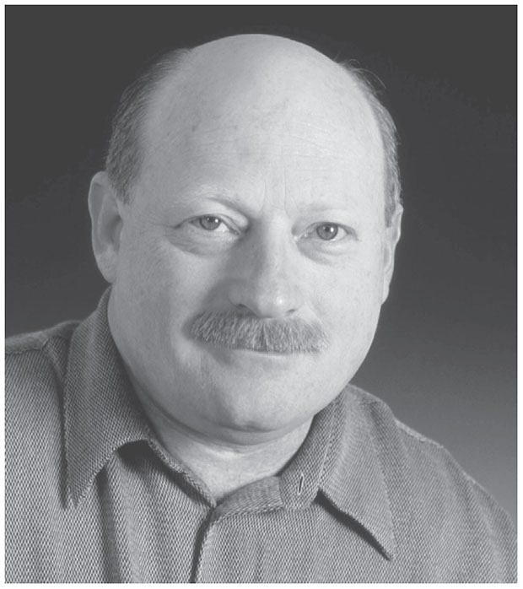
User Design and Language Design

